Slide 1

CLOUD WEB SERVICES
Unit 3 :Web Applications and Security
Version Code: CWS1
Released Date: 3-Dec-2018
1

Slide 2
Web Applications and Security
AIM:
To familiarize students about AWS Applications and brief description of Security in AWS.
2

Slide 3
Web Applications and Security
Objectives:
The objectives of this module are to understand:
About deploying and publishing applications.
Creating infrastructure by writing script.
Cloud watch and usage.
Introduction to AWS messaging services.
How to restrict the users on AWS resources by creating IAM roles and policies.
How to create directory service in AWS.
2

Slide 4
Web Applications and Security
Outcome
The outcome of this module are to explain/describe:
Understanding platforms supported by AWS to deploy the applications using Elastic Beanstalk
Monitoring the AWS resources using cloud watch
AWS Cloud Formation support the creation of infrastructure by writing script
Introduction to AWS messaging services such as SQS,
SNS service helps for sending notifications through SMS or email
SES is used to send and receive the mails
IAM roles and policies helps to assign the permissions for users.
AWS Directory service provide the authentication and authorization for own domain.
2

Slide 5
Web Applications and Security
Content
AWS Elastic Beanstalk
AWS Cloud watch
AWS Cloud Formation
AWS messaging services such as SQS, SNS and SES
AWS Security services
AWS Identity and Access Management (IAM)
AWS Directory service
AWS Key management Service [KMS]
Securing Data at Rest
2

Slide 6
Web Applications and Security
AWS Elastic BeanStalk
2

Slide 7
Web Applications and Security
AWS elastic Beanstalk
AWS Elastic Beanstalk is an easy-to-use service for deploying and scaling web applications and services developed with Java, .NET, PHP, Node.js, Python, Ruby, Go, and Docker on familiar servers such as Apache, Nginx, Passenger, and IIS.
We can simply upload your code and Elastic Beanstalk automatically handles the deployment,
from capacity provisioning, load balancing, auto-scaling to application health monitoring.
2

Slide 8
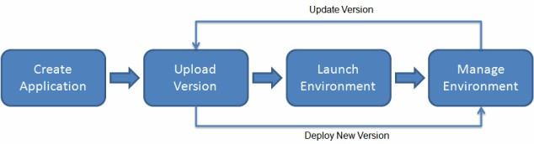
Web Applications and Security
Workflow of Elastic Beanstalk
To use Elastic Beanstalk, you create an application, upload an application version in the form of an application source bundle (for example, a Java .war file) to Elastic Beanstalk, and then provide some information about the application.
Elastic Beanstalk automatically launches an environment and creates and configures the AWS
resources needed to run your code.
After your environment is launched, you can then manage your environment and deploy new
application versions.
2

Slide 9
Web Applications and Security
Elastic Beanstalk Supported Platforms
AWS Elastic Beanstalk provides platforms for programming languages (Java, PHP, Python, Ruby, Go), web containers (Tomcat, Passenger, Puma) and Docker containers, with multiple configurations of each.
Elastic Beanstalk provisions the resources needed to run your application, including one or more Amazon EC2 instances. The software stack running on the Amazon EC2 instances depends on the configuration. In a configuration name, the version number refers to the version of the platform configuration.
Platforms
.NET on Windows Server with IIS
Node.js
PHP
Python
Ruby
Packer Builder
Single Container Docker
Multi-container Docker
Preconfigured Docker
Go
Java SE
Java with Tomcat
9

Slide 10
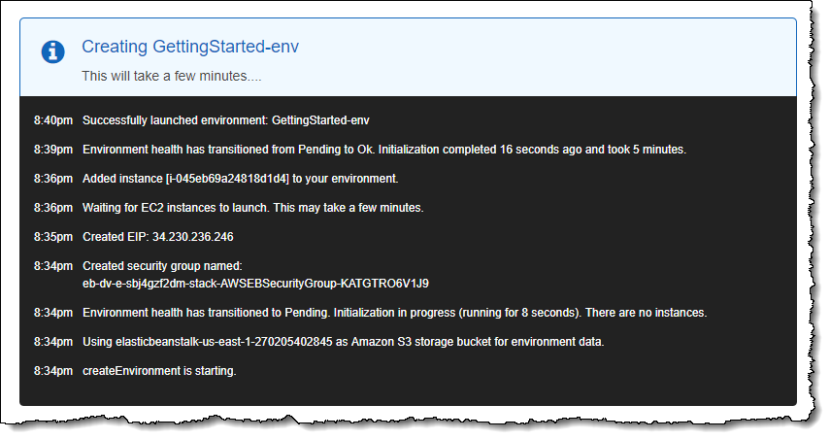
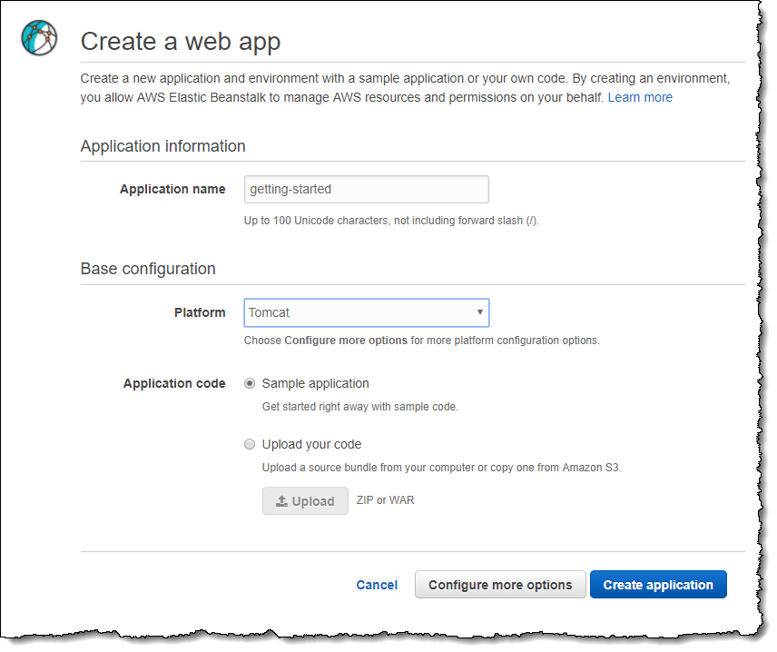
Web Applications and Security
Create an Application
Creates a new application version named Sample Application, which refers to the default Elastic Beanstalk sample application file.
Deploys the sample application code to GettingStartedApp-env.
10

Slide 11
Web Applications and Security
CloudFormation

Slide 12
Web Applications and Security
What is CloudFormation?
AWS CloudFormation provides a common language for you to describe and provision all the
infrastructure resources in your cloud environment.
CloudFormation allows you to use a simple text file to model and provision, in an automated and
secure manner, all the resources needed for your applications across all regions and accounts.
This file serves as the single source of truth for your cloud environment.
AWS CloudFormation is available at no additional charge, and you pay only for the AWS resources needed to run your applications.

Slide 13
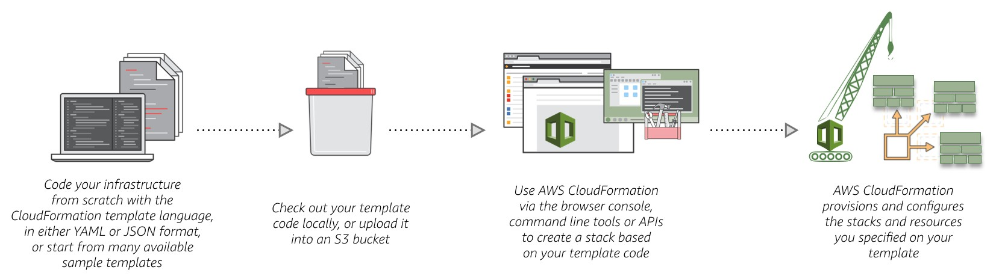
Web Applications and Security
What is CloudFormation?

Slide 14
Web Applications and Security
AWS CloudFormation Features
Authoring with JSON/YAML: AWS CloudFormation allows you to model your entire infrastructure in a text file. You can use JSON or YAML to describe what AWS resources you want to create and configure.
Safety Controls: AWS CloudFormation automates the provisioning and updating of your infrastructure in a safe and controlled manner. If any of the alarms are breached, CloudFormation rolls back the entire stack operation to a previous deployed state.
Preview Changes to your Environment: AWS CloudFormation Change Sets allows you to
preview how proposed changes to a stack might impact your running resources.
Dependency Management: AWS CloudFormation automatically manages dependencies between your resources during stack management actions.
Cross Account and Cross-Region Management: AWS StackSets that lets you provision a common set of AWS resources across multiple accounts and regions with a single CloudFormation template.
Extensibility: AWS CloudFormation enables you to build custom extensions to your stack
template using AWS Lambda.

Slide 15
Web Applications and Security
AWS CloudFormation Concepts
When you use AWS CloudFormation, you work with templates and stacks. You create templates to describe your AWS resources and their properties. Whenever you create a stack, AWS CloudFormation provisions the resources that are described in your template.
Templates: An AWS CloudFormation template is a JSON or YAML formatted text file. You can save these files with any extension, such as .json, .yaml, .template, or .txt. AWS CloudFormation uses these templates as blueprints for building your AWS resources.
Stacks: When you use AWS CloudFormation, you manage related resources as a single unit called a stack. You create, update, and delete a collection of resources by creating, updating, and deleting stacks. All the resources in a stack are defined by the stack's AWS CloudFormation template.
Change Sets: If you need to make changes to the running resources in a stack, you update the stack. Before making changes to your resources, you can generate a change set, which is a summary of your proposed changes. Change sets allow you to see how your changes might impact your running resources, especially for critical resources, before implementing them.

Slide 16
Web Applications and Security
Creating a Template
Example: if you create a stack with the following JSON template, AWS CloudFormation provisions an instance with an ami-0ff8a91507f77f867 AMI ID, t1.micro instance type, testkey key pair name, and an Amazon EBS volume.
{ {
"AWSTemplateFormatVersion" : "2010-09-09", "Description" : "A sample template", "Resources" : {
"MyEC2Instance" : {
"Type" : "AWS::EC2::Instance",
"Properties" : {
"ImageId" : "ami-0ff8a91507f77f867", "InstanceType" : "t1.micro", "KeyName" : "testkey", "BlockDeviceMappings" : [
"DeviceName" : "/dev/sdm", "Ebs" : {
"VolumeType" : "io1",
"Iops" : "200",
"DeleteOnTermination" : "false",
"VolumeSize" : "20"
} } ] } } }}

Slide 17
Web Applications and Security
Cloud Watch

Slide 18
Web Applications and Security
Cloud watch
Amazon Cloud Watch provides a reliable, scalable, and flexible monitoring solution that you can start using within minutes. You no longer need to set up, manage, and scale your own monitoring systems and infrastructure.
Use Cloud Watch to monitor your AWS resources and the applications you run on AWS in real time.
Use Cloud Watch Events to send system events from AWS resources to AWS Lambda functions,
Amazon SNS topics, streams in Amazon Kinesis, and other target types.
Use Cloud Watch Logs to monitor, store, and access your log files from Amazon EC2 instances, AWS Cloud Trail, or other sources.

Slide 19
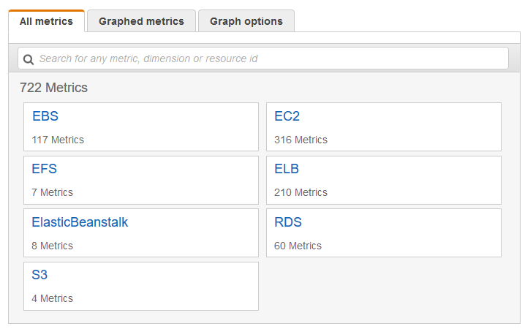
Web Applications and Security
Cloud metrics
Metrics are grouped first by namespace, and then by the various dimension combinations within each namespace. For example, you can view all EC2 metrics, EC2 metrics grouped by instance, or EC2 metrics grouped by Auto Scaling group.
To view available metrics by namespace and dimension using the console
Open the CloudWatch console
at https://console.aws.amazon.com/cloudwatch/
In the navigation pane, choose Metrics.
Select a metric namespace (for example, EC2).

Slide 20
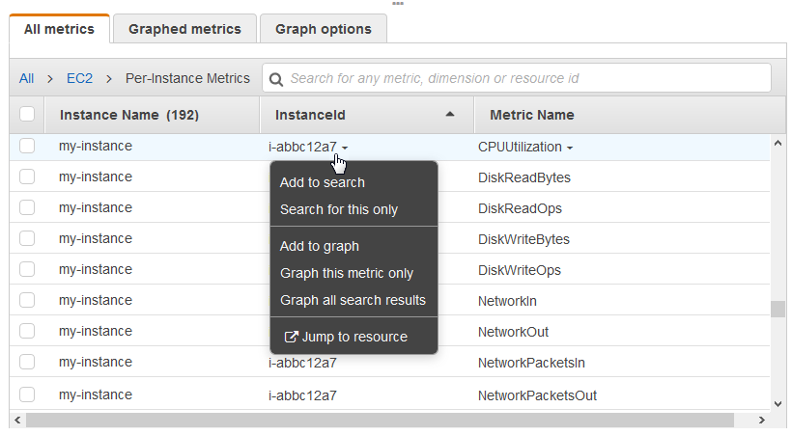
Web Applications and Security
Selecting Metrics for given instance id
The All metrics tab displays all metrics for that dimension in the namespace. You can do the following:
To sort the table, use the column heading.
To graph a metric, select the check box next to the metric. To select all metrics, select the check box in the heading row of the table.
To filter by resource, choose the resource
ID and then choose Add to search.
To filter by metric, choose the metric
name and then choose Add to search.

Slide 21
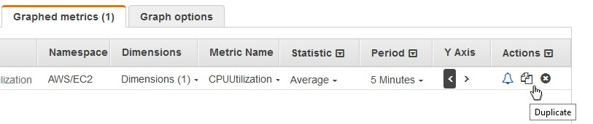
Web Applications and Security
Graph a Metric
You can select metrics and create graphs of the data using the CloudWatch console.
CloudWatch supports the following statistics on
metrics: Average, Minimum, Maximum, Sum, and Sample Count.
You can view your data at different granularities. For example, you can choose a detailed view or You can choose a less detailed view (for example, 1 hour), which can be useful when viewing a broader time range.

Slide 22
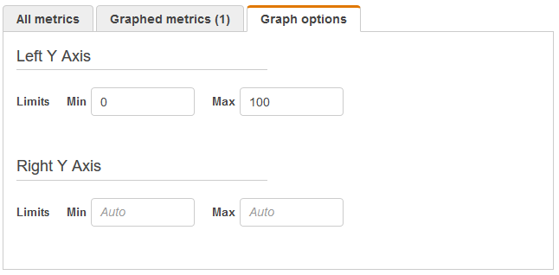
Web Applications and Security
Graph Options
You can set custom bounds for the Y axis on a graph to help you see the data better. For example, you can change the bounds on a CPU Utilization graph to 100 percent so that it is easy to see whether the CPU is low (the plotted line is near the bottom of the graph) or high (the plotted line is near the top of the graph).
You can switch between two different Y axes for your graph. This is useful if the graph contains metrics that have different units or that differ greatly in their range of values.

Slide 23
Web Applications and Security
Cloud watch alarm
The new cloud watch Alarms feature allows to watch Cloud Watch metrics and to receive notifications when the metrics fall outside of the levels (high or low thresholds) that you configure. We can attach multiple Alarms to each metric and each one can have multiple actions.
A Cloud Watch Alarm is always in one of three states: OK, ALARM, or INSUFFICIENT_DATA. When the metric is within the range that you have defined as acceptable, the Monitor is in the OK state. When it breaches a threshold it transitions to the ALARM state. If the data needed to make the decision is missing or incomplete, the monitor transitions to the INSUFFICIENT_DATA state.
Alarms watch metrics and execute actions by publishing notifications to Amazon SNS topics or by
initiating Auto Scaling actions. SNS can deliver notifications using HTTP, HTTPS, and Email.

Slide 24
Web Applications and Security
To create alarm in cloud watch
Open the Cloud Watch console at https://console.aws.amazon.com/cloudwatch/.
In the navigation pane, choose Alarms, Create Alarm.
For the Select Metric step, perform the following:
Choose a metric category (for example, EC2 Metrics).
Select an instance and metric (for example, CPU Utilization).
Choose a period (for example, 1 Hour).
Choose Next.
For the Define Alarm step, perform the following:
Under Alarm Threshold, type a unique name for the alarm and a description of the alarm. For Whenever, specify a threshold (for example, 80 percent of CPU utilization) and the number of data points ("M" out of "N") that must be breaching to trigger the alarm.
Under Additional settings, for Treat missing data as, choose how to have the alarm treat missing data points. For more information, see Configuring How Cloud Watch Alarms Treat Missing Data.
Under Actions, select the type of action to have the alarm to perform when the alarm is triggered.
Choose Create Alarm.
24

Slide 25
Web Applications and Security
The following services are used along with Amazon CloudWatch:
Amazon Simple Notification Service (Amazon SNS): You use Amazon SNS with CloudWatch to send messages when an alarm threshold has been reached.
Amazon EC2 Auto Scaling
It enables you to automatically launch or terminate Amazon EC2 instances based on user- defined policies, health status checks, and schedules.
You can use a CloudWatch alarm with Amazon EC2 Auto Scaling to scale your EC2
instances based on demand.
AWS CloudTrail
It enables you to monitor the calls made to the Amazon CloudWatch API for your account, including calls made by the AWS Management Console, AWS CLI, and other services.
When CloudTrail logging is turned on, CloudWatch writes log files to the Amazon S3 bucket that you specified when you configured CloudTrail.
AWS Identity and Access Management (IAM) is a web service that helps you securely control
access to AWS resources for your users.

Slide 26
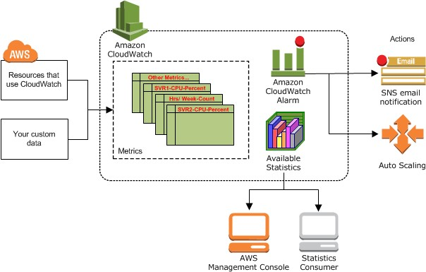
Web Applications and Security
How Amazon CloudWatch Works?
You can configure alarm actions to stop, start, or terminate an Amazon EC2 instance when certain criteria are met.
In addition, you can create alarms that initiate Amazon EC2 Auto Scaling and Amazon Simple Notification Service (Amazon SNS) actions on your behalf.

Slide 27
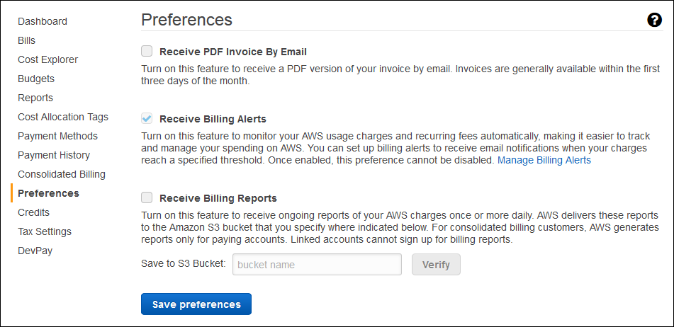
Web Applications and Security
Monitor Your Estimated Charges Using CloudWatch
You can choose to receive alerts by email when charges have exceeded a certain threshold. These alerts are triggered by CloudWatch and messages are sent using Amazon Simple Notification Service (Amazon SNS).
Tasks
Step 1: Enable Billing Alerts Step 2: Create a Billing Alarm Step 3: Check the Alarm Status Step 4: Edit a Billing Alarm Step 5: Delete a Billing Alarm

Slide 28
Web Applications and Security
AWS Messaging Services

Slide 29
Web Applications and Security
AWS Messaging Services
Simple Notification Service
Amazon Simple Notification Service (SNS) is a flexible, fully managed pub/sub messaging and mobile notifications service for coordinating the delivery of messages to subscribing endpoints and clients.
With SNS you can fan-out messages to a large number of subscribers, including distributed
systems and services, and mobile devices.
It is easy to set up, operate, and reliably send notifications to all your endpoints – at any scale.
You can get started using SNS in a matter of minutes using the AWS Management Console, AWS Command Line Interface, or using the AWS SDK with just three simple APIs.
SNS eliminates the complexity and overhead associated with managing and operating dedicated
messaging software and infrastructure.
29

Slide 30
Web Applications and Security
Amazon SNS Pricing
Amazon SNS has no upfront costs and you can pay as you go. You pay based on the number of notifications you publish, the number of notifications you deliver, and any additional API calls for managing topics and subscriptions. Delivery pricing varies by endpoint type. You can get started for free with the SNS free tier.
It costs $1.00 to send one million mobile push notifications ($0.50 per million publishes, plus $0.50
per million mobile push notification deliveries).
When you use SNS topics to broadcast identical messages to many recipients at once, your effective
price can be even lower than $1.00 per million mobile push notifications.
With the SNS free tier, your first million push notifications (publishes and deliveries) are free every
month.
Note that data transfer charges may apply. You can estimate your bill using the AWS Simple Monthly Calculator.
30

Slide 31
Web Applications and Security
Publishes
Includes publish, topic owner operations, and subscriber operations, but not deliveries.
First 1 million Amazon SNS requests per month are free.
$0.50 per 1 million Amazon SNS requests thereafter.
Amazon SNS currently allows a maximum limit of 256 KB for published messages.
Each 64KB chunk of published data is billed as 1 request. For example, a single API call with a 256KB payload will be billed as four requests.

Slide 32
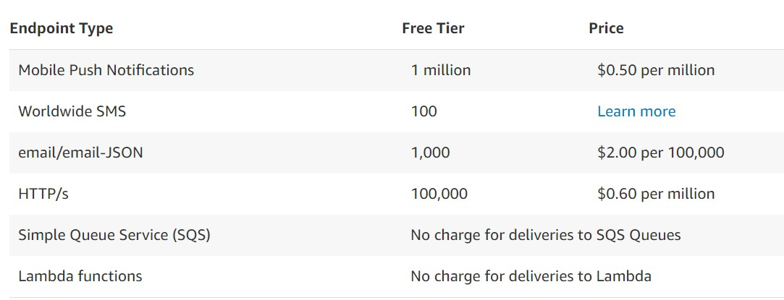
Web Applications and Security
Notification Deliveries
Note: Each 64KB chunk of delivered data is billed as 1 request. For example, a single notification
with a 256KB payload will be billed as four deliveries.

Slide 33
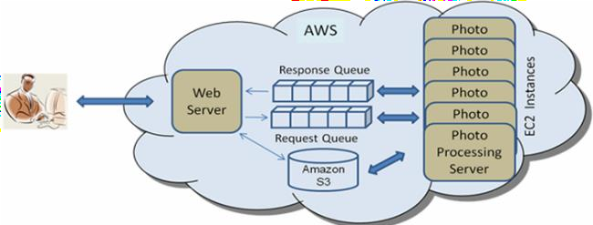
Web Applications and Security
Amazon Simple Queue Service
Amazon Simple Queue Service (SQS) is a fully managed message queuing service that enables you to decouple and scale micro services, distributed systems, and server less applications.
SQS eliminates the complexity and overhead associated with managing and operating message oriented middleware, and empowers developers to focus on differentiating work.
Using SQS, you can send, store, and receive messages between software components at any volume, without losing messages or requiring other services to be available.
SQS offers two types of message queues.
Standard queues offer maximum throughput, best-effort
ordering, and at-least-once delivery.
SQS FIFO queues are designed to guarantee that messages are
processed exactly once, in the exact order that they are sent.
33

Slide 34
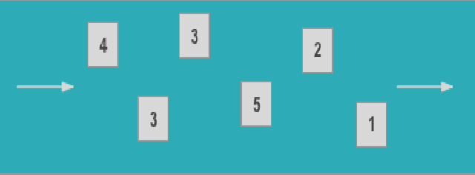
Web Applications and Security
Standard Queue
Unlimited Throughput: Standard queues support a nearly unlimited
number of Transactions Per Second (TPS) per API action.
At-Least-Once Delivery: A message is delivered at least once, but occasionally more than one copy of a message is delivered.
Best-Effort Ordering: Occasionally, messages might be delivered in
an order different from which they were sent.
You can use standard message queues in many scenarios, as long as your application can process messages that arrive more than once and out of order, for example:
Decouple live user requests from intensive background work:
Let users upload media while resizing or encoding it.
Allocate tasks to multiple worker nodes: Process a high number of credit card validation requests.
Batch messages for future processing: Schedule multiple entries
to be added to a database.
34

Slide 35

Web Applications and Security
FIFO Queues
High Throughput: By default, FIFO queues support up to 300 messages per second (300 send, receive, or delete operations per second).
Exactly-Once Processing: A message is delivered once and remains available until a consumer processes and deletes it. Duplicates are not introduced into the queue.
First-In-First-Out Delivery: The order in which messages are sent and received is strictly
preserved (i.e., First-In-First-Out).
FIFO queues are designed to enhance messaging between applications when the order of
operations and events is critical, or where duplicates cannot be tolerated, for example:
Ensure that user-entered commands are executed in the right order.
Display the correct product price by sending price modifications in the right order.
Prevent a student from enrolling in a course before registering for an account.

Slide 36
Web Applications and Security
Functionality of SQS
Unlimited queues and messages: Creates unlimited Amazon SQS queues with an unlimited number of message in any region.
Payload Size: Message payloads can contain up to
256KB of text in any format.
Batches: Send, receive, or delete messages in batches of up to 10 messages or 256KB.
Long polling: Reduce extraneous polling to minimise cost while receiving new messages as quickly as possible.
Retain messages in queues for up to 14 days.
Send and read messages simultaneously.
Message locking: When a message is received, it
becomes “locked” while being processed.
Queue sharing: Securely share Amazon SQS queues anonymously or with specific AWS accounts. Queue sharing can also be restricted by IP address and time- of-day.
Server-side encryption (SSE): Protect the contents of messages in Amazon SQS queues using keys managed in the AWS Key Management Service (AWS KMS). SSE encrypts messages as soon as Amazon SQS receives them.
Dead Letter Queues (DLQ): Handle messages that have not been successfully processed by a consumer with Dead Letter Queues.

Slide 37
Web Applications and Security
Amazon Simple Email Service
Amazon Simple Email Service (Amazon SES) is a cloud-based email sending service designed to help digital marketers and application developers send marketing, notification, and transactional emails.
It is a reliable, cost-effective service for businesses of all sizes that use email to keep in
contact with their customers.
You can use our SMTP interface or one of the AWS SDKs to integrate Amazon SES
directly into your existing applications.
You can also integrate the email sending capabilities of Amazon SES into the software you already use, such as ticketing systems and email clients.

Slide 38
Web Applications and Security
Amazon SES Features
High Deliverability
Content Personalization
Authentication
Dedicated IP Addresses
Monitoring
Sender Reputation Management
Flexible Email Receiving
Multiple Email Sending Interfaces
Mailbox Simulator
AWS Integration
Pay Only For What You Use

Slide 39
Web Applications and Security
Before You Begin with Amazon SES
You need to set up Amazon SES.
Whether you send an email by using the Amazon SES console, the SMTP interface, or the Amazon SES API, you need to:
Sign up for AWS—Before you can use Amazon SES or other AWS services, you need to create
an AWS account.
Verify your email address or domain— To send emails using Amazon SES, you always need to verify your "From" address to show that you own it. If you are in the sandbox, you also need to verify your "To" addresses. You can verify email addresses or entire domains.

Slide 40
Web Applications and Security
Consider the following factors when you verify email addresses for use with Amazon SES:
You must verify each identity that you use as a "From," "Source," "Sender," or "Return-Path" address.
You can, however, add a label to an email address that has already been verified without performing any additional verification steps.
Email addresses are case sensitive. If you verify sender@EXAMPLE.com, you cannot send email from
sender@example.com unless you verify sender@example.com as well.
If you verify both an email address and the domain that address belongs to, the settings for the email address override those of the domain. For example, if Domain Keys Identified Mail (DKIM) is enabled for the domain example.com, but not for sender@example.com, emails sent from sender@example.com are not DKIM signed.
Amazon SES has endpoints in multiple AWS Regions, and the verification status of the email address is separate
for each region.
If you want to send email from the same identity in more than one region, you must verify that identity in each
region.
In each AWS Region, you can verify up to 10,000 identities (email addresses or domains, in any combination).

Slide 41

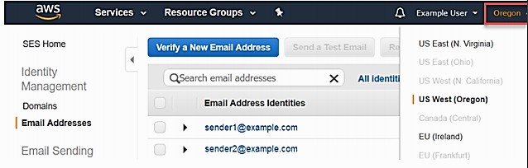
Web Applications and Security
Verifying Email Addresses in Amazon SES
Sign in to the AWS Management Console and open the Amazon SES console at https:// console.aws.amazon.com/ses/.
In the console, use the region selector to choose the AWS Region where you want to verify the email address, as shown in the following image.
In the navigation pane, under Identity Management, choose Email Addresses.
Choose Verify a New Email Address.
In the Verify a New Email Address dialog box, type your email address in the Email Address field, and then choose Verify This Email Address.
Check the inbox for the email address that you are verifying. You will receive a message with the following subject line: "Amazon Web Services - Email Address Verification Request in region RegionName,"
In the Amazon SES console, under Identity Management, choose Email Addresses. In the list of email addresses, locate the email address you are verifying. If the email address was verified, the value in the Status column is "verified".
41

Slide 42
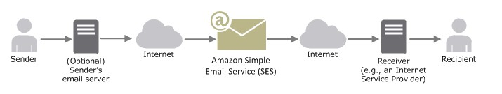
Web Applications and Security
Sending Email with Amazon SES
When you use Amazon SES, Amazon SES becomes your outbound email server. You can also keep your existing email server and configure it to send your outgoing emails through Amazon SES so that you do not have to change any settings in your email clients. The following diagram shows where Amazon SES fits in to the email sending process.
A sender can generate the email content in different ways. A sender can create the email by using an email client application, or use a program that automatically generates emails, like an application that sends order confirmations in response to purchase transactions.
There are several ways that you can send an email by using Amazon SES. You can use the Amazon SES console, the Simple Mail Transfer Protocol (SMTP) interface, or you can call the Amazon SES API.

Slide 43
Web Applications and Security
Receiving Email with Amazon SES
Amazon Simple Email Service (Amazon SES) is a mail server that can both send and receive mail on your behalf. When you use Amazon SES to receive your mail, Amazon SES handles underlying mail-receiving operations, such as:
Communicating with other mail servers
Scanning for spam and viruses
Rejecting mail from untrusted sources
Accepting mail for recipients in your domain
When you use Amazon SES as your email receiver, you must tell the service what to do with your mail. The primary method, which gives you fine-grained control over your mail, is to specify the actions to take based on the recipient. The other method is to block or allow mail based on the originating IP address.

Slide 44
Web Applications and Security
AWS Security

Slide 45
Web Applications and Security
AWS Cloud Security
Cloud security at AWS is the highest priority. As an AWS customer, you will benefit from a data centre and network architecture built to meet the requirements of the most security-sensitive organizations.
An advantage of the AWS cloud is that it allows customers to scale and innovate, while maintaining a secure environment.
Customers pay only for the services they use, meaning that you can have the security you need, but without the upfront expenses, and at a lower cost than in an on-premises environment.

Slide 46
Web Applications and Security
Benefits of AWS Security
Keep Your Data Safe
The AWS infrastructure puts strong safeguards in place to help protect customer privacy. All data is stored in highly secure AWS data centres.
Meet Compliance Requirements
AWS manages dozens of compliance programs in its infrastructure. This means that
segments of your compliance have already been completed.
Save Money
Cut costs by using AWS data centres. Maintain the highest standard of security without having to manage your own facility.
Scale Quickly
Security scales with your AWS cloud usage. No matter the size of your business the AWS infrastructure is designed to keep data safe.

Slide 47
Web Applications and Security
AWS Cloud Security Services
AWS Identity and Access Management (IAM)- Manage user access and encryption keys
Amazon Cloud Directory-Create flexible cloud-
native directories
Amazon Cognito - Identity management for your apps
Amazon GuardDuty - Managed threat detection
service
Amazon Inspector - Analyze application security
Amazon Macie - Discover, classify, and protect your data
AWS Artifact-On-demand access to AWS’
compliance reports
AWS Certificate Manager- Provision, manage,
and deploy SSL/TLS certificates
AWS Cloud HSM- Hardware-based key storage for
regulatory compliance
AWS Directory Service-Host and manage active directory
AWS Firewall Manager-Central management of firewall rules
AWS Key Management Service- Managed creation and
control of encryption keys
AWS Organizations- Policy-based management for
multiple AWS accounts
AWS Secrets Manager- Rotate, manage, and retrieve secrets
AWS Shield- DDoS protection
AWS Single Sign-On - Cloud single sign-on (SSO) service
AWS WAF - Filter malicious web traffic

Slide 48
Web Applications and Security
Identity and Access Management (IAM)

Slide 49
Web Applications and Security
What is IAM?
AWS Identity and Access Management (IAM) is a web service that helps securely control access to AWS resources. We can use IAM to control who is authenticated (signed in) and authorized (has permissions) to use resources.
When you first create an AWS account, we begin with a single sign-in identity that has complete access to all AWS services and resources in the account. This identity is called the AWS
account root user and is accessed by signing in with the email address and password that you used to create the account.

Slide 50
Web Applications and Security
IAM Features
Shared access to your AWS account.
Granular permissions.
Secure access to AWS resources for applications that run on Amazon EC2.
Integrated with many AWS services.
Eventually Consistent.

Slide 51
Web Applications and Security
Components of IAM
We can create new user and use permission to allow or deny their access to AWS resources.
User
Created users divided into groups than role and policies are applied on the groups.
Group
IAM role is set of permissions for making AWS service request.
Role
To assign permissions to a group, users, role.
Policies

Slide 52
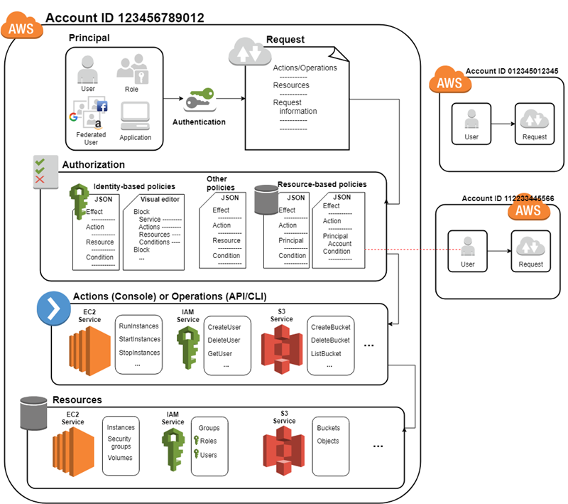
Web Applications and Security
Understanding How IAM Works
Before you create users, you should understand how IAM works. IAM provides the infrastructure necessary to control authentication and authorization for your account.
The IAM infrastructure includes the following
elements:
Principal
Request
Authentication
Authorization
Actions or Operations
Resources

Slide 53
Web Applications and Security
Overview of Identity Management: Users
For greater security and organization, you can give access to your AWS account to specific users—identities that you create with custom permissions. You can further simplify access for those users by federating existing identities into AWS.
First-Time Access Only: Your Root User Credentials
When you create an AWS account, you create an AWS account root user identity, which you used to sign in to AWS. You can sign in to the AWS Management Console using this root user identity—that is, the email address and password that you provided when creating the account.
IAM Users
IAM users are not separate accounts; they are users within your account. Each user can have its own password for access to the AWS Management Console. You can also create an individual access key for each user so that the user can make programmatic requests to work with resources in your account.
Federating Existing Users
If the users in your organization already have a way to be authenticated, such as by signing in to your
corporate network, you do not have to create separate IAM users for them. Instead, you
can federate those user identities into AWS.
53

Slide 54
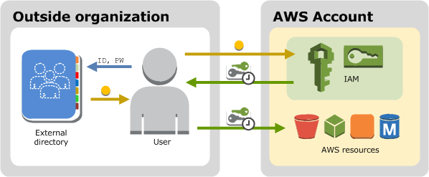
Web Applications and Security
Federating Existing Users
The following diagram shows how a user can use IAM to get temporary AWS security credentials to access resources in your AWS account.
Federation is particularly useful in these cases:
Your users already have identities in a corporate directory
If your corporate directory is compatible with Security Assertion Markup Language 2.0 (SAML 2.0), you can configure your corporate directory to provide single-sign on (SSO) access to the AWS Management Console for your users.
Your users already have Internet identities
If you are creating a mobile app or web-based app that can let users identify themselves through an Internet identity provider like Login with Amazon, Facebook, Google, or any OpenID Connect (OIDC) compatible identity provider, the app can use federation to access AWS.
54

Slide 55
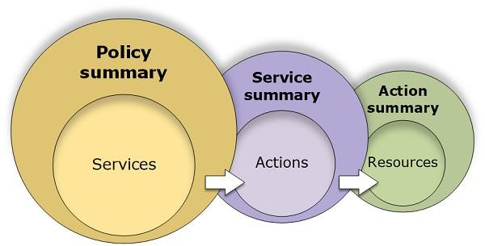
Web Applications and Security
Permissions and Policies
The access management portion of AWS Identity and Access Management (IAM) helps you define what a user or other entity is allowed to do in an account.
This process is often referred to as authorization.
Permissions are categorized as permissions policies and permissions boundaries.
Most permission policies are JSON policy documents in AWS that, when attached to an identity or resource, define their permissions.
A permission boundary is an advanced feature that allows you to use policies to limit the maximum permissions that a principal can have.
These boundaries can be applied to AWS Organizations, IAM users or roles.
55

Slide 56
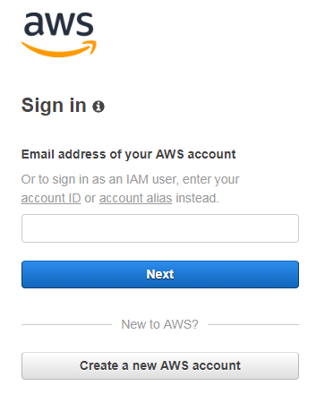
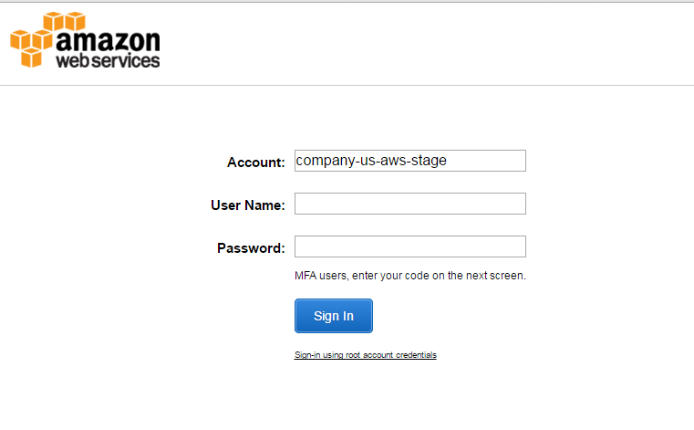
Web Applications and Security
Root and IAM User Login Page
IAM User login page : To login as IAM user you must enter the username and password along with Account ID or Account alias
Root user login page
56

Slide 57
Web Applications and Security
AWS Directory Service

Slide 58
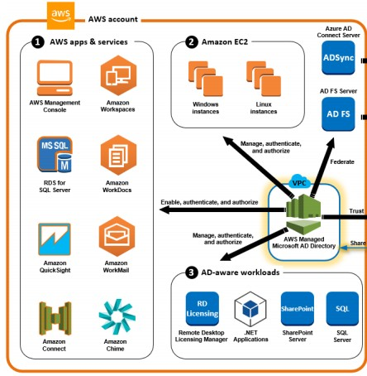
Web Applications and Security
AWS Directory Service
AWS Directory Service provides multiple ways to set up and run Amazon Cloud Directory, Amazon Cognito, and Microsoft AD with other AWS services.
Amazon Cloud Directory provides a highly scalable directory store for your application’s multi hierarchical data.
Amazon Cognito helps you create a directory store that authenticates your users either through your own user pools or through federated identity providers.
AWS Directory Service for Microsoft Active Directory (Enterprise Edition), also known as Microsoft AD, enables your directory-aware workloads and AWS resources to use a managed Active Directory in the AWS Cloud.
58

Slide 59
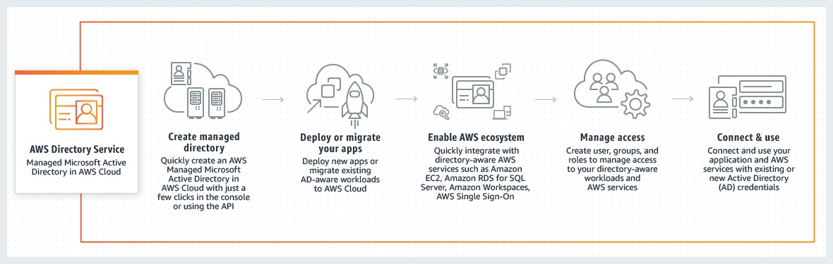
Web Applications and Security
How AWS Directory Service works

Slide 60
Web Applications and Security
Advantages of AWS Directory Service
AWS Directory Service makes it easy to set up and run directories in the AWS Cloud, or connect your AWS resources with an existing on-premises Microsoft Active Directory.
Once your directory is created, you can use it for a variety of tasks such as:
Manage users and groups.
Provide single sign-on to applications and services.
Create and apply group policy.
Securely connect to Amazon EC2 Linux and Windows instances.
Simplify the deployment and management of cloud-based Linux and Microsoft Windows workloads.
You can use AWS Managed Microsoft AD to enable multi-factor authentication by integrating with your existing RADIUS-based MFA infrastructure to provide an additional layer of security when users access AWS applications.

Slide 61
Web Applications and Security
AWS Managed Microsoft AD Prerequisites
To create a AWS Managed Microsoft AD directory, you need a VPC with the following:
At least two subnets.
Each of the subnets must be in a different Availability Zone.
The VPC must have default hardware tenancy.
You cannot create a AWS Managed Microsoft AD in a VPC using addresses in the
198.19.0.0/16 address space.
AWS Directory Service does not support using Network Address Translation (NAT) with Active Directory. Using NAT can result in replication errors.

Slide 62
Web Applications and Security
AWS Managed Microsoft AD Prerequisites
The following ports must be open between the two
subnets that you deploy your directory into.
This is necessary to allow the domain controllers that AWS Directory Service creates for you to communicate with each other.
A security group will be created and attached to your directory to enable communication between the domain controllers.
TCP/UDP 53 - DNS
TCP/UDP 88 - Kerberos authentication
UDP 123 – NTP
TCP 135 - RPC
UDP 137-138 - Netlogon
TCP 139 - Netlogon
TCP/UDP 389 - LDAP
TCP/UDP 445 - SMB
TCP 636 - LDAPS (LDAP over TLS/SSL)
TCP 873 - Rsync
TCP 3268 - Global Catalog
TCP/UDP 1024-65535 - Ephemeral ports for RPC

Slide 63
Web Applications and Security
Create Your AWS Managed Microsoft AD directory
To create an AWS Managed Microsoft AD directory:
In the AWS Directory Service console navigation pane, choose Directories and then choose Set up
directory.
On the Select directory type page, choose AWS Managed Microsoft AD, and then choose Next.
On the Enter directory information page, provide the following information: Edition, Directory
DNS name, Directory NetBIOS name, Directory description, Admin password,
On the Choose VPC and subnets page, provide the following information, and then choose Next.
VPC The VPC for the directory.
Subnets Choose the subnets for the domain controllers. The two subnets must be in different Availability Zones.
On the Review and create page, review the directory information and make any necessary
changes. When the information is correct, choose Create directory. Creating the directory takes 20
to 40 minutes. Once created, the Status value changes to Active.

Slide 64
Web Applications and Security
AWS Key Management Service (KMS)
AWS Key Management Service (KMS) is a managed service that makes it easy for you to create and control the encryption keys used to encrypt your data, and uses FIPS 140-2 validated hardware security modules to protect the security of your keys.
AWS Key Management Service is integrated with most other AWS services to help you protect the
data you store with these services.
AWS Key Management Service is also integrated with AWS CloudTrail to provide you with logs of all key usage to help meet your regulatory and compliance needs.
64

Slide 65
Web Applications and Security
Benefits of KMS
AWS Key Management Service is a fully managed service, so you can focus on the encryption needs of your applications while AWS handles availability, physical security, and hardware maintenance of the underlying infrastructure.
AWS Key Management Service provides you with centralised control of your encryption keys.
AWS Key Management Service is integrated with several other AWS services to make it easy to encrypt the data you store with these services using keys that you manage.
KMS provides an SDK for programmatic integration of encryption and key management into your applications.
AWS Key Management Service works with AWS CloudTrail to provide you with logs of API calls made to or
by KMS.
There is no charge for the storage of default keys in your account. You pay only for additional master keys that
you create and your key usage.
KMS keys are never transmitted outside of the AWS regions in which they were created.
Security and quality controls in AWS KMS have been validated and certified by a number of compliance
schemes.
65

Slide 66
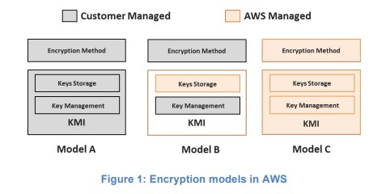
Web Applications and Security
Securing Data at Rest and In Motion
Amazon Web Services (AWS) delivers a secure, scalable cloud computing platform with high availability, offering the flexibility for you to build a wide range of applications.
If you require an additional layer of security for the data you store in the cloud, there are several options for encrypting data at rest— ranging from completely automated AWS encryption solutions to manual, client-side options.
As you deploy encryption for various data classifications in AWS, it is important to understand exactly who has access to your encryption keys or data and under what conditions. As shown in Figure 1, there are three different models for how you and/or AWS provides the encryption method and the KMI.
You control the encryption method and the entire KMI.
You control the encryption method, AWS provides the storage component of the KMI, and you provide the management layer of the Key Management Infrastructure (KMI).
AWS controls the encryption method and the entire KMI.
66

Slide 67
Web Applications and Security
Self Assessment Questions
67

Slide 68
Web Applications and Security
Self Assessment Questions
Which one of the given options serves as a platform for AWS Elastic Beanstalk?
Programming languages (Java, PHP, Python, Ruby, Go)
Web containers (Tomcat, Passenger, Puma)
Docker containers
Only i
Only ii
Only i and iii
All i, ii and iii
Answer: All i, ii and iii
67

Slide 69
Web Applications and Security
Self Assessment Questions
Cloud watch is used for .
Creating servers
Monitoring different computing web services
Creating storage
Answer: Monitoring different computing web services
67

Slide 70
Web Applications and Security
Self Assessment Questions
Which one of the given options are used by S3 bucket?
Storage
Hosting static web sites
To create database
Only i
Only ii
Only i and ii
All i, ii and iii
Answer: Only i and ii
67

Slide 71
Web Applications and Security
Self Assessment Questions
Which one of the given options are created by IAM services?
Users and Groups
IAM Roles
Policies
Only i
Only ii
Only i and ii
All i, ii and iii
Answer: All i, ii and iii

Slide 72
Web Applications and Security
Self Assessment Questions
Which of the following is not RDS service in AWS?
MySQL
Oracle
Maria DB
Dynamo DB
Answer: Dynamo DB

Slide 73
Web Applications and Security
Self Assessment Questions
Static website can be hosted using storage service.
Elastic Beanstalk
S3 bucket
EBS
Glacier
Answer: S3 bucket

Slide 74
Web Applications and Security
Self Assessment Questions
Security groups in AWS add .
Rules to specific instance
Security to prevent access
Features so that user can access
Answer: Rules to specific instance

Slide 75
Web Applications and Security
Self Assessment Questions
Elastic beanstalk is used to .
Add rules to specific instance
Add security to prevent access
Deploy scalable web services
Answer: Deploy scalable web services

Slide 76
Web Applications and Security
Self Assessment Questions
Which one of the given options can be deployed using elastic beanstalk?
PHP and Python
JAVA
Node JS
Only i
Only ii
Only i and ii
All i, ii and iii
Answer: All i, ii and iii

Slide 77
Web Applications and Security
Self Assessment Questions
10. Which one of the given statement is true for KMS Service?
AWS Key Management Service provides you with centralized control of your encryption
keys.
There is no charge for the storage of default keys in your account. You pay only for additional master keys that you create and your key usage.
KMS keys are never transmitted outside of the AWS regions in which they were created.
iii.
Only i
Only ii
Only i and ii
All i, ii and iii
Answer: All i, ii and iii
77

Slide 78
Web Applications and Security
Self Assessment Questions
11. You can create and manage users, groups, and policies by using
IAM APIs and the AWS CLI
The IAM console
The visual editor and the IAM policy simulator
All the above
Answer: All the above

Slide 79
Web Applications and Security
Self Assessment Questions
12. Do IAM user names have to be email addresses?
Yes
No
No, but they can be.
None of the above
Answer: No, but they can be.

Slide 80
Web Applications and Security
Self Assessment Questions
Which statement is true for an IAM role and an IAM user?
An IAM user has permanent long-term credentials and is used to directly interact with AWS services.
An IAM role does not have any credentials and cannot make direct requests to AWS
services.
IAM roles are meant to be assumed by authorized entities, such as IAM users, applications, or an AWS service such as EC2.
d. All of the above
Answer: All of the above
80

Slide 81
Web Applications and Security
Self Assessment Questions
14. How many IAM roles can I create without requesting AWS to increase the IAM limit
a. 500
b. 1000
c. 1500
d. 10000
Answer: 1000

Slide 82
Web Applications and Security
Self Assessment Questions
What are the features of IAM roles for EC2 instances?
AWS temporary security credentials to use when making requests from running EC2 instances to AWS services.
Automatic rotation of the AWS temporary security credentials.
Granular AWS service permissions for applications running on EC2 instances.
All of the above
Answer: All of the above

Slide 83
Web Applications and Security
Assignment
Deploy and test the PHP/ASP.NET application in the AWS Elastic Beanstalk.
Configure the Auto scaling for the deployed application.
Create a Virtual machine using cloud Formation script.
Configure the Cloud Watch to monitor virtual machines using any five metrics.
Configure the mail notification for the Virtual Machine if it exceeds the CPU usage 60%.
Write the test case for SQS.
Make document to create SES.
Perform the following task using IAM
Create Group named ObjectRead
Create 4 users and add to the group
Assign S3-Readonly policy for ObjectRead Group
Login with one of the user and verify.
Make a document on Active Directory.
Make a document on KMS.

Slide 84
Web Applications and Security
Summary
Elastic Beanstalk helps to deploy and publish the applications written in different languages.
Monitoring the AWS resources using cloud watch.
AWS CloudFormation allows you to model your entire infrastructure in a text file. You can use JSON
or YAML to describe what AWS resources you want to create and configure.
Using SQS, you can send, store, and receive messages between software components at any volume,
without losing messages or requiring other services to be available.
SNS service helps for sending notifications through SMS or email.
Amazon Simple Email Service (Amazon SES) is a cloud-based email sending service.
IAM roles and policies helps to assign the permissions for users.
AWS Directory Service provides multiple ways to set up and run Amazon Cloud Directory, Amazon
Cognito, and Microsoft AD with other AWS services.
84

Slide 85
Web Applications and Security
Document Links
Topic | URL | Notes
AWS Elastic Beanstalk | https://docs.aws.amazon.com/elastic-beanstalk/index.html#lang/en_us | AWS Elastic Beanstalk
AWS Cloud watch | https://docs.amazonaws.cn/en_us/AmazonCloudWatch/latest/monitoring/ WhatIsCloudWatch.html | AWS Cloud watch
AWS Cloud Formation | https://docs.aws.amazon.com/AWSCloudFormation/latest/UserGuide/cf n-ug.pdf | AWS Cloud Formation
SQS | https://docs.aws.amazon.com/AWSSimpleQueueService/latest/SQSDevelo perGuide/welcome.html | SQS
SNS | https://docs.aws.amazon.com/sns/latest/dg/welcome.html | SNS
SES | https://docs.aws.amazon.com/ses/latest/DeveloperGuide/ses-dg.pdf | SES
IAM | https://docs.aws.amazon.com/IAM/latest/UserGuide/introduction.html | IAM
AWS Directory service | https://docs.aws.amazon.com/directoryservice/latest/admin- guide/what_is.html | AWS Directory service
KMS | https://docs.aws.amazon.com/kms/latest/developerguide/kms-dg.pdf | KMS

Slide 86
Web Applications and Security
Video Links
Topic | URL | Notes
AWS Elastic Beanstalk | https://www.youtube.com/watch?v=rvxucBBDlPQ | AWS Elastic Beanstalk
AWS Cloud watch | https://www.youtube.com/watch?v=ekHzOPzR1wA | AWS Cloud watch
AWS Cloud Formation | https://www.youtube.com/watch?v=LDSMIvUuFOE | AWS Cloud Formation
SQS | https://www.youtube.com/watch?v=4Z74luiE2bg | SQS
SNS | https://www.youtube.com/watch?v=YC-sVSbeowA | SNS
SES | https://www.youtube.com/watch?v=5PT5e8iQyBc | SES
IAM | https://www.youtube.com/watch?v=9CKsX6MOPDQ | IAM
AWS Directory service | https://www.youtube.com/watch?v=XNTsmRe8k7Q | AWS Directory service
KMS | https://www.youtube.com/watch?v=-5MPXHvKDnc | KMS

Slide 87
Web Applications and Security
E-book references
Web Link | Topic Name | Page Numbers
https://awsdocs.s3.amazonaws.com/gettin gstarted/latest/awsgsg-intro.pdf | S3 | 17-23
http://aad.tpu.ru/1955/Java%20books/Rab bitMQ%20Essentials.pdf | SQS | 1-71
http://fit.mta.edu.vn/files/DanhSach/Book _Amazon%20webservices%20for%20dumm ies.pdf | Storage, Networking , Security | 53-183

